Slide 1

Report Writing
Representing Data with Excel

Slide 2
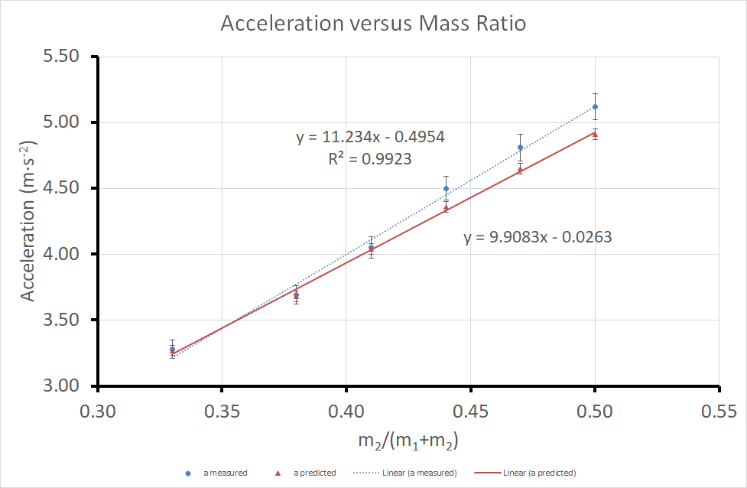
Aims of Activity
To produce a high quality graph from experimental data using Excel.
To add linear trendlines to a graph using Excel.
To add error bars to a graph using Excel.

Slide 3
Good Graphs
When producing an experimental graph it is useful to consider the following checklist
Title | Trendline
Data Spread | Equation and R²
Axis Labelled (including units) | Predicted and Measured Results
Appropriate Variables | Uncertainty Error Bars
We will cover how to produce a graph with all of these elements in todays computer lab.

Slide 4
Good Graphs
The Graph has a title.
Axis are labelled and have appropriate units.

Slide 5
Good Graphs
The data is spread out over the entire graph.
Appropriate variables are plotted on the x and y axis.

Slide 6
Good Graphs
Predicted and measured results are shown.
Uncertainty error bars are shown.

Slide 7
Good Graphs
A trendline has been plotted.
The equation and R² value of the trendline are shown.

Slide 8
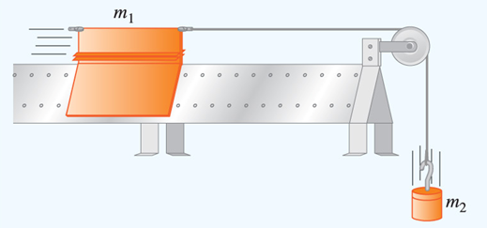
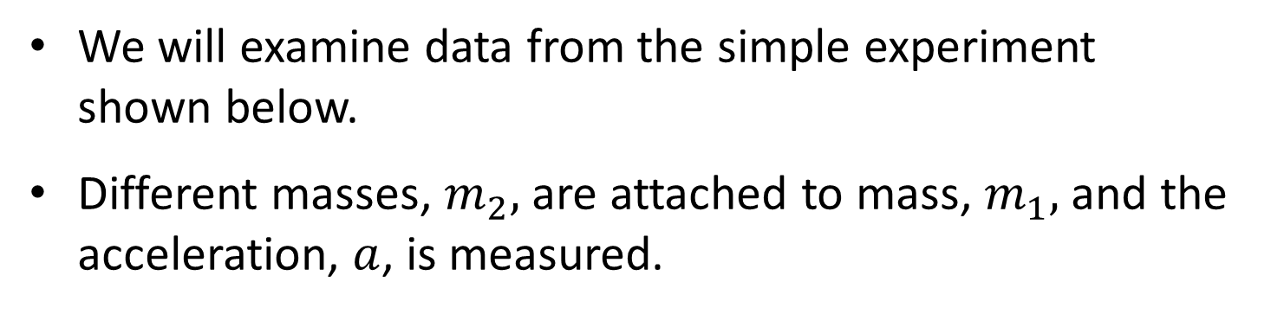
Introduction
We will examine data from the simple experiment shown below.
Different masses, $m_{2},$ are attached to mass, $m_{1},$ and the acceleration, $a$, is measured.

Slide 9
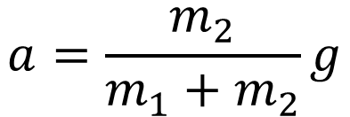
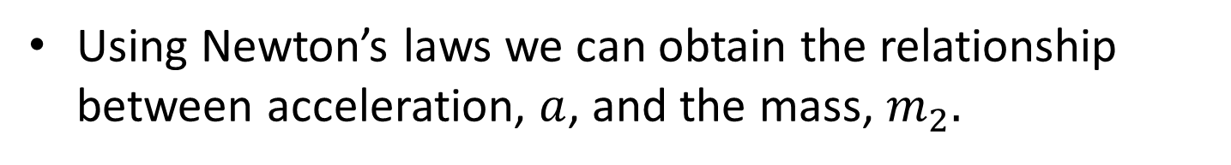
Introduction
Using Newton’s laws we can obtain the relationship between acceleration, $a$, and the mass, $m_{2}.$
$$a=\frac{m_{2}}{m_{1}+m_{2}}g$$
Where m ₁(100 g) is the mass of the vehicle.
m₂ is the mass of the falling weight.
a is the acceleration.
g is the gravitational constant.

Slide 10
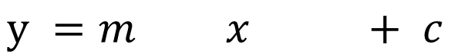
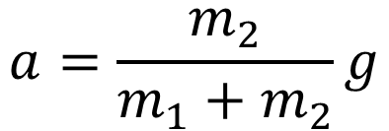
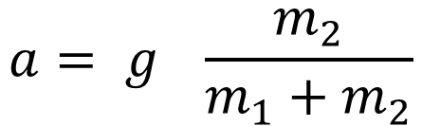
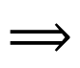
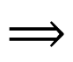
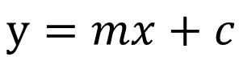
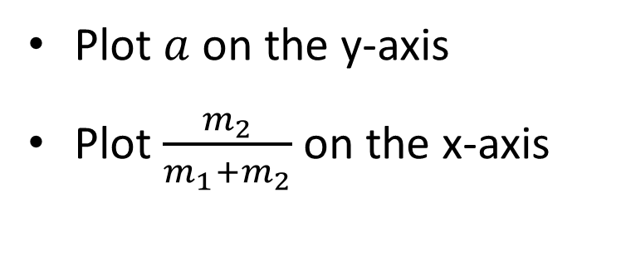
Introduction
We then compare our equation to the standard equation for a straight line
$$a=\frac{m_{2}}{m_{1}+m_{2}}g$$
$$a= g \frac{m_{2}}{m_{1}+m_{2}}$$
$$⟹$$
$$y=mx+c$$
$$⟹$$
$$y =m x + c$$
Plot $a$ on the y-axis
Plot $\frac{m_{2}}{m_{1}+m_{2}}$ on the x-axis

Slide 11
Part 1
Representing Data with Excel:
Producing a Good Graph

Slide 12
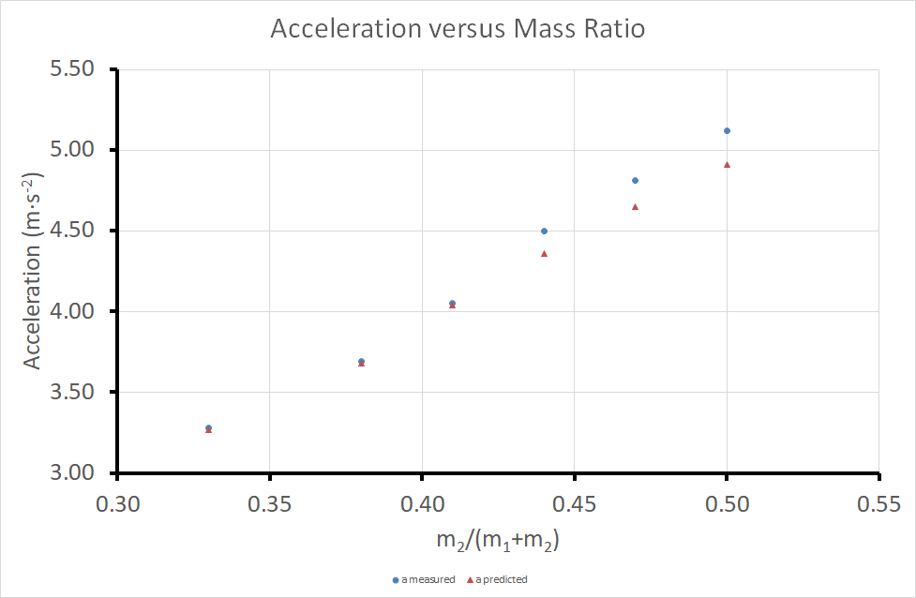
Part 1 – Producing a Good Graph
Lets first look at how to produce a good graph

Slide 13
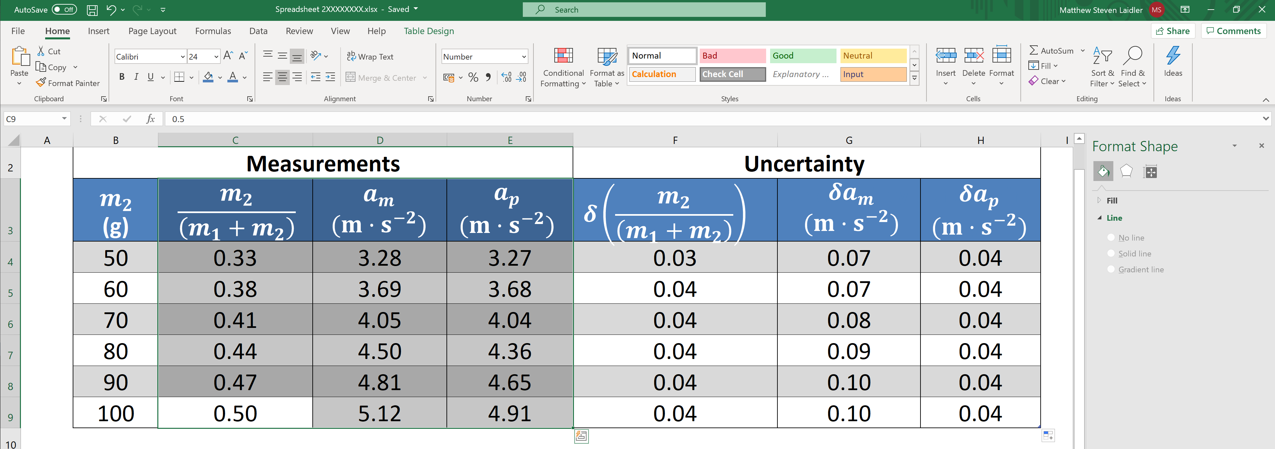
Highlight the data you wish to include (both x values and the measured and predicted y values)
Part 1 – Producing a Good Graph

Slide 14
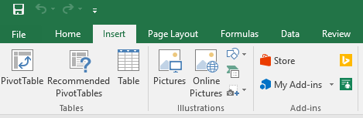
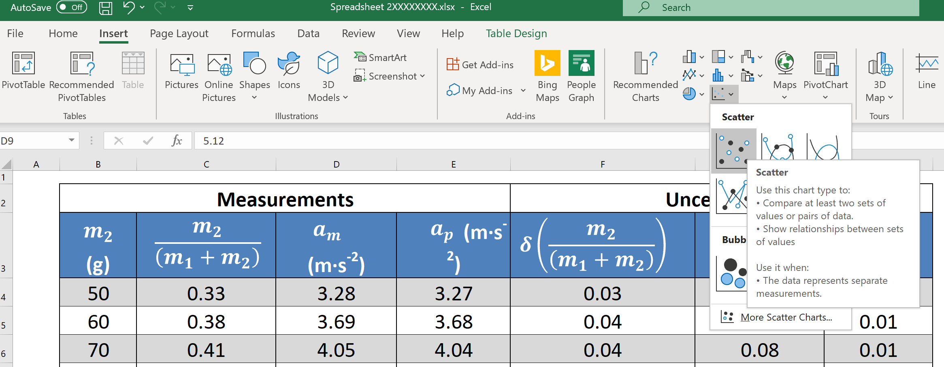
Select the Insert tab from the top menu
Part 1 – Producing a Good Graph
Then choose Scatter

Slide 15
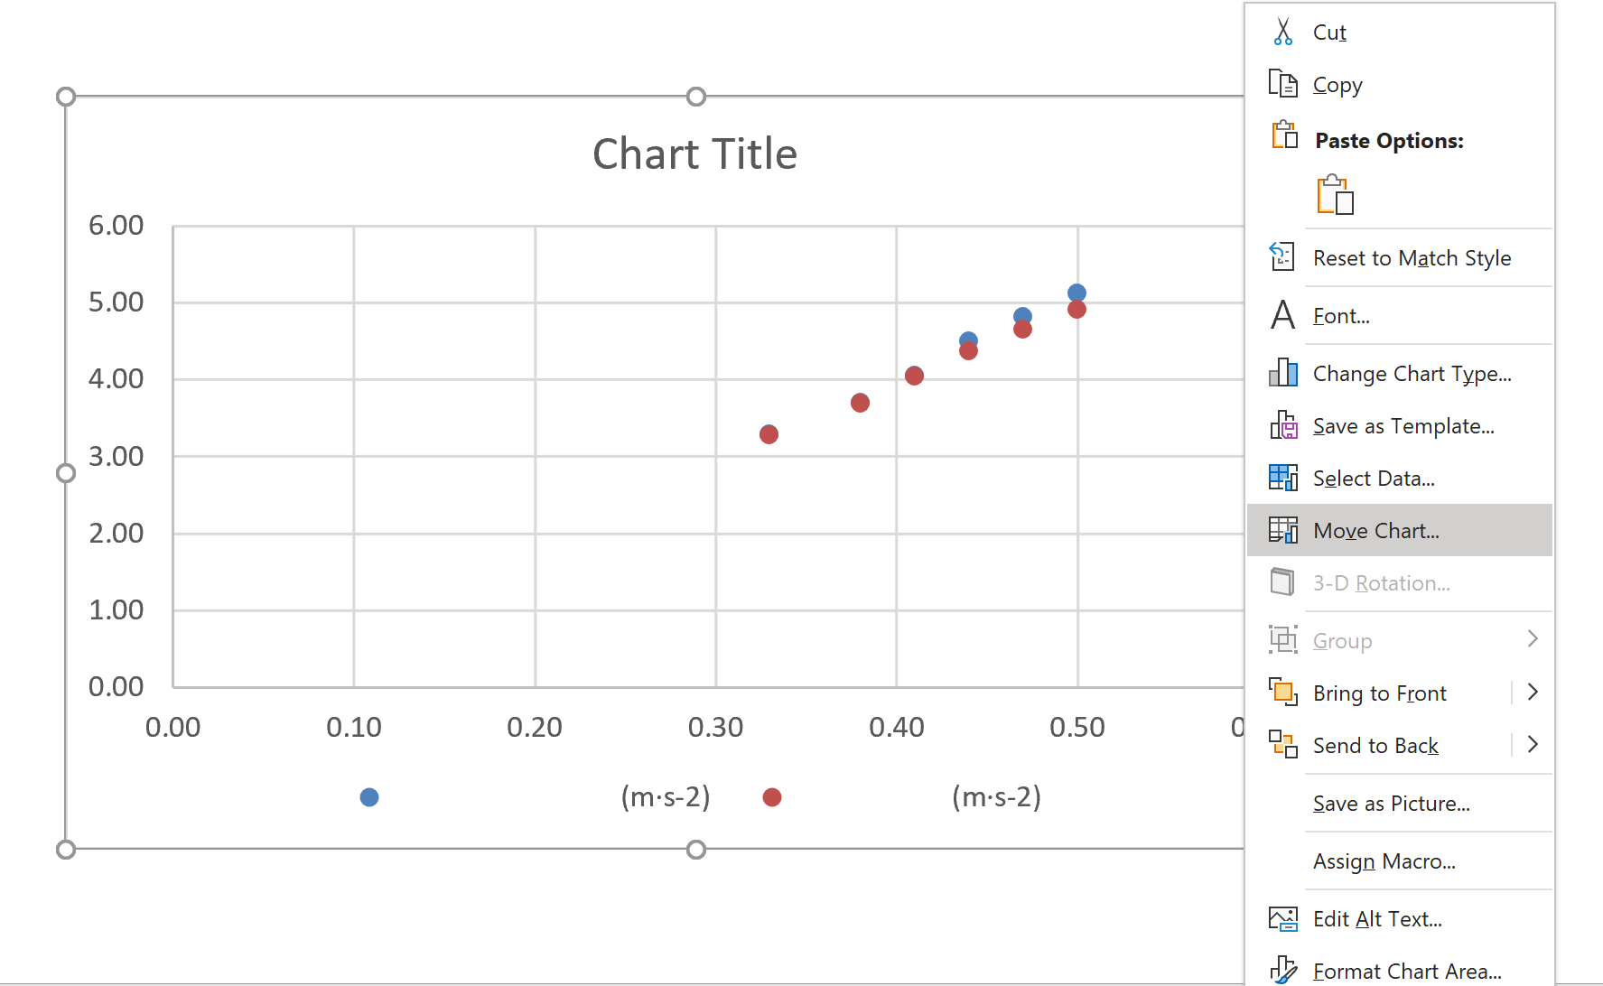
Next click on the chart, then right click and select Move Chart in the menu.
Part 1 – Producing a Good Graph

Slide 16
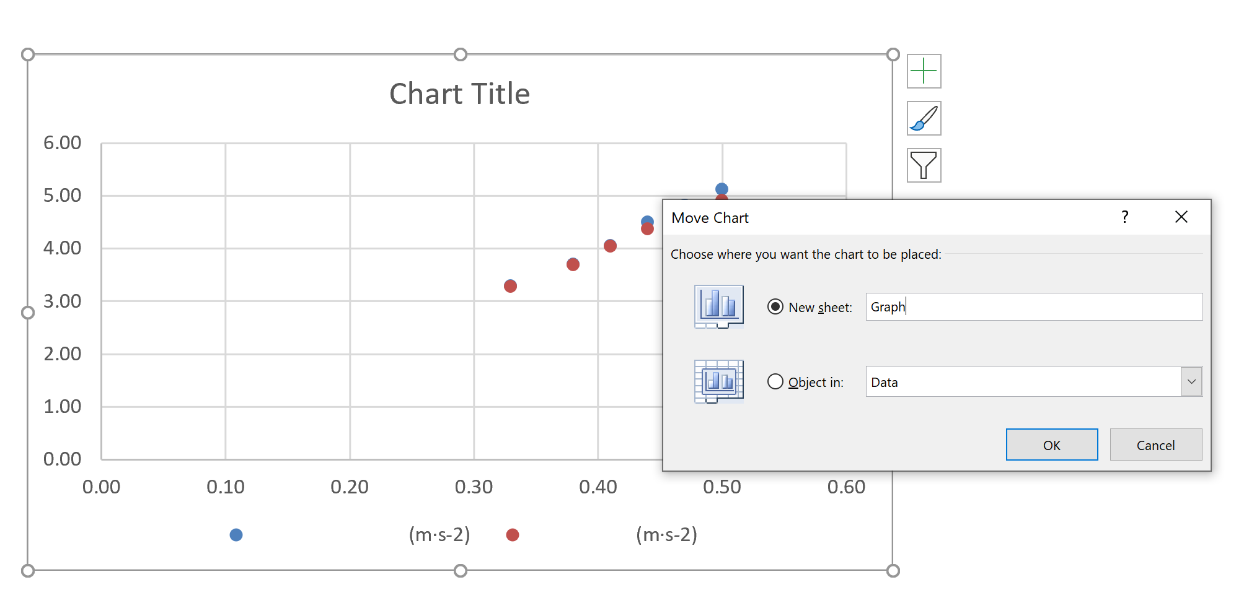
In the move chart window select New sheet. Then change the name to “Graph” and click on Ok.
Part 1 – Producing a Good Graph

Slide 17
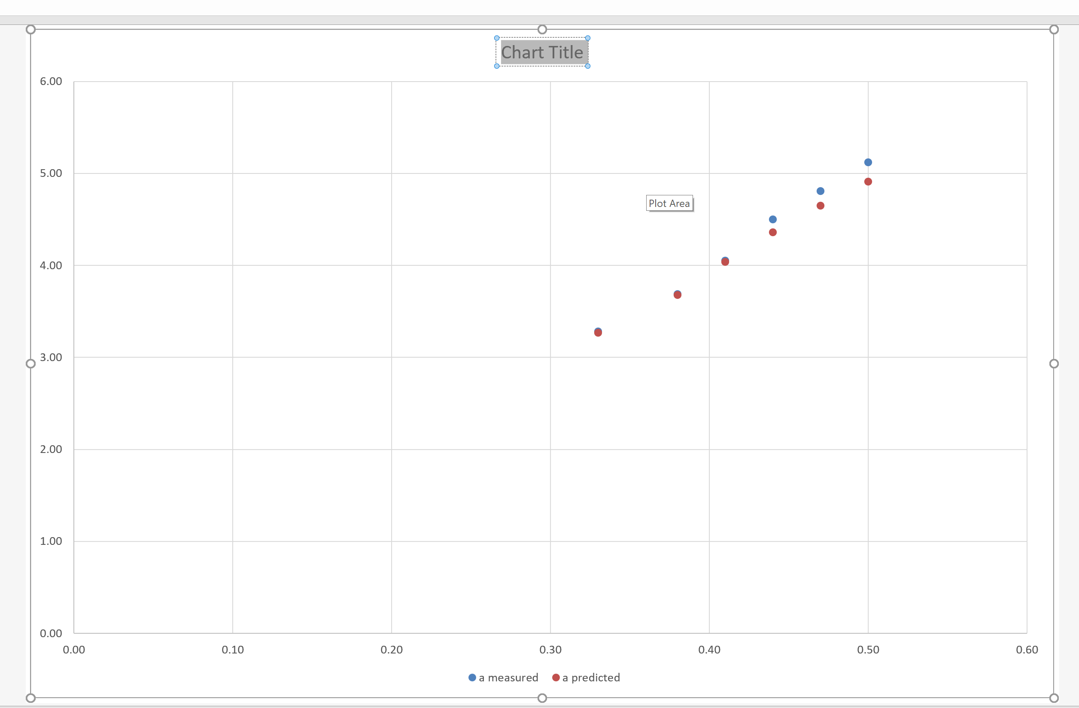
Highlight “Chart Title”, delete this text and type in the new the title of the graph;
Part 1 – Producing a Good Graph
“Acceleration versus Mass Ratio”

Slide 18
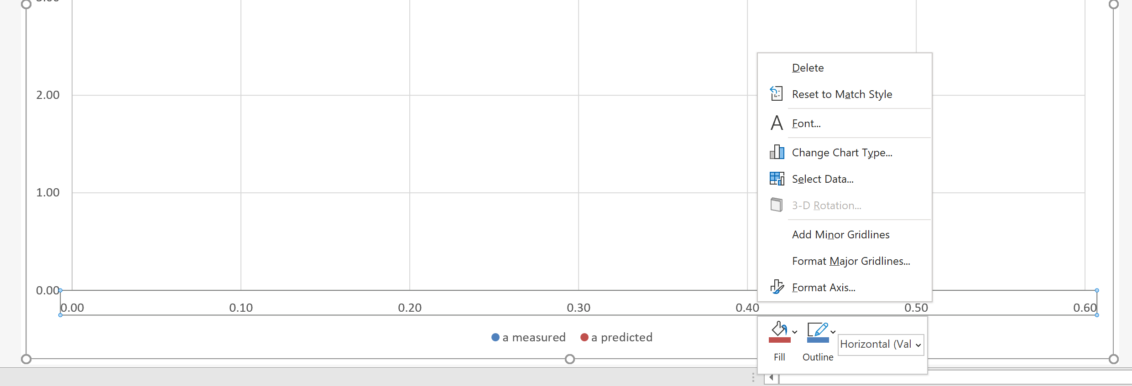
Left click any number on the x-axis, and then right click, selecting format axis from the menu.
Part 1 – Producing a Good Graph

Slide 19
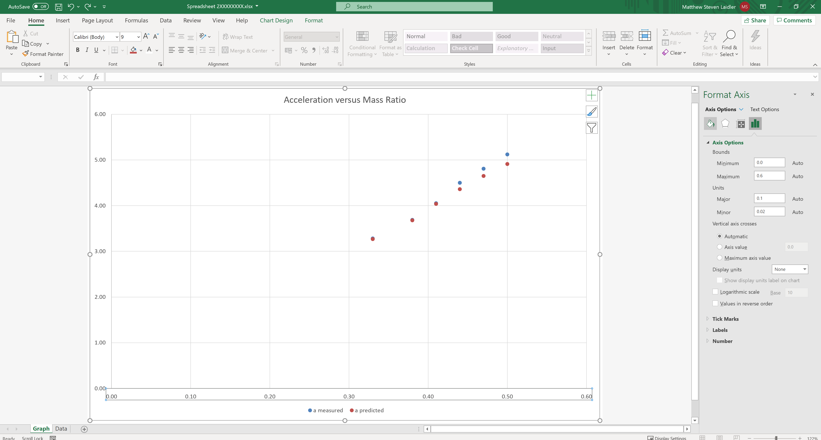
Click on Fill & Line in the Format Axis menu.
Part 1 – Producing a Good Graph

Slide 20
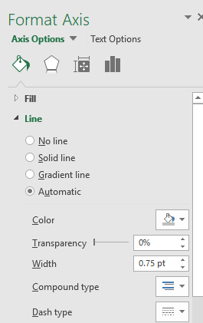
Select Line and set the line colour to black and adjust the Width to 3 and. Repeat the process for the y-axis.
Part 1 – Producing a Good Graph

Slide 21
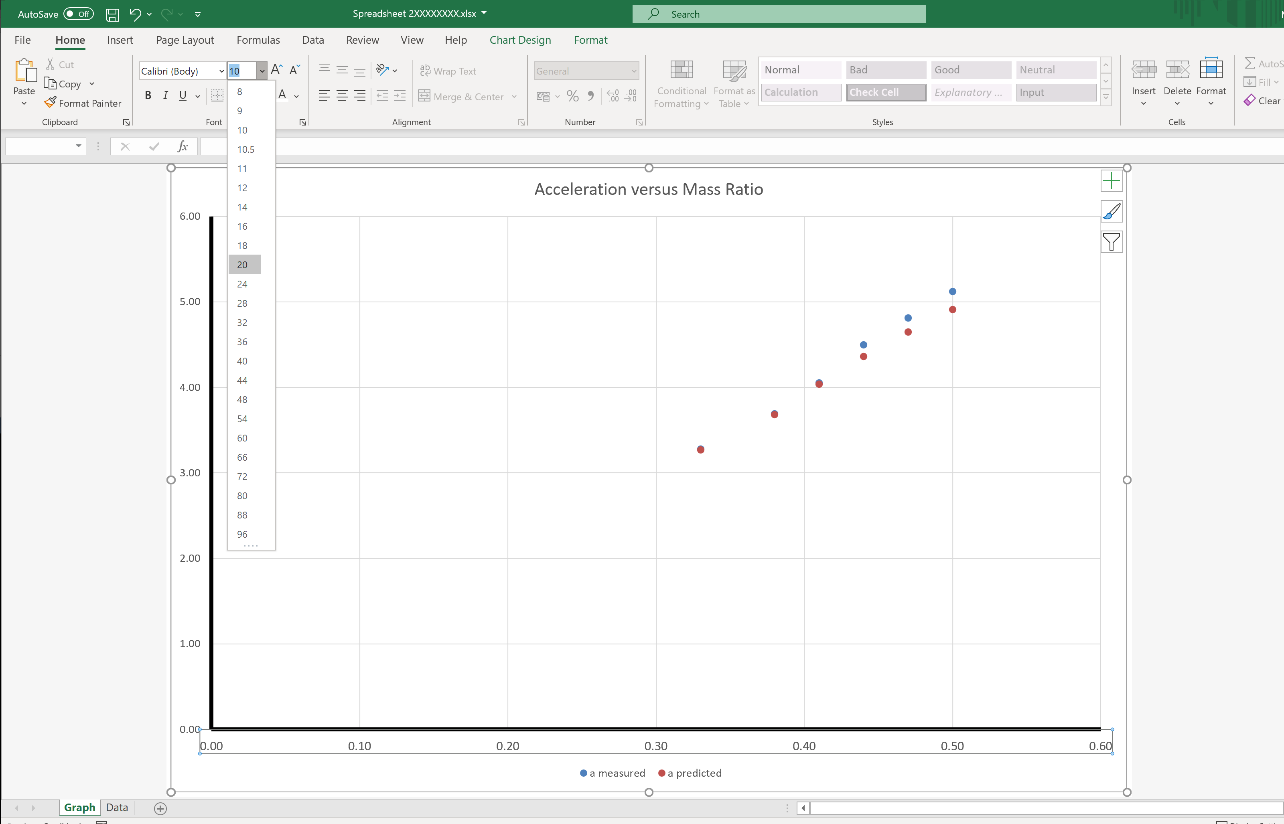
Left click on any number on x-axis, select the Home tab and adjust the font size to 20. Repeat for the y-axis.
Part 1 – Producing a Good Graph

Slide 22
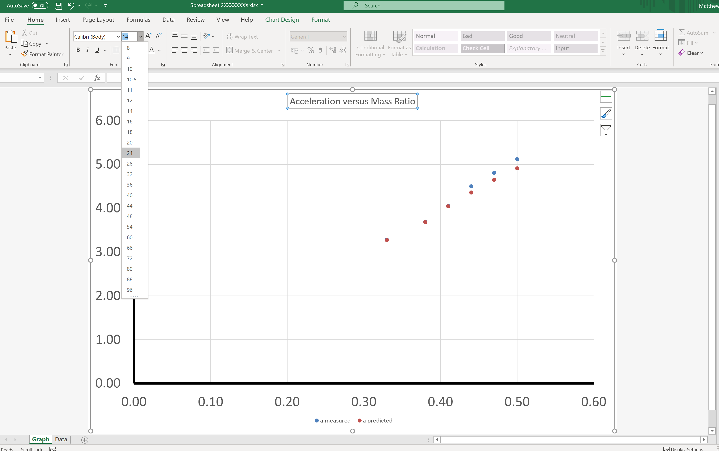
Left click on the graph title and set the font size to 24.
Part 1 – Producing a Good Graph

Slide 23
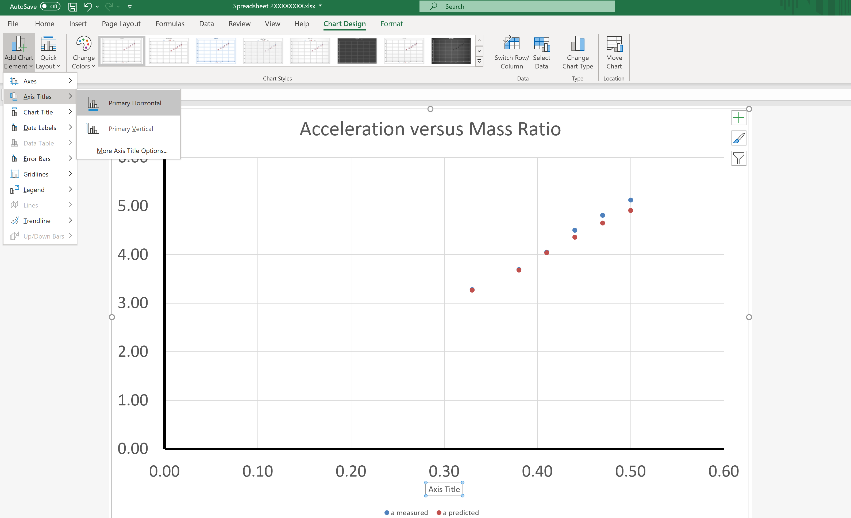
Click Chart Design > Add Chart Element > Axis Titles > Primary Horizontal
Part 1 – Producing a Good Graph

Slide 24
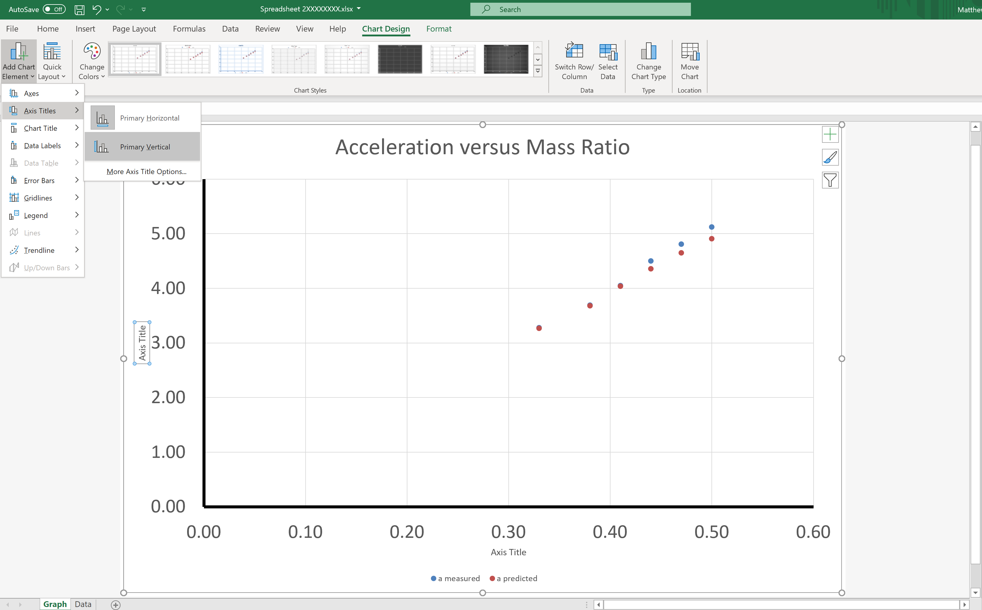
Click Chart Design > Add Chart Element > Axis Titles > Primary Vertical
Part 1 – Producing a Good Graph

Slide 25
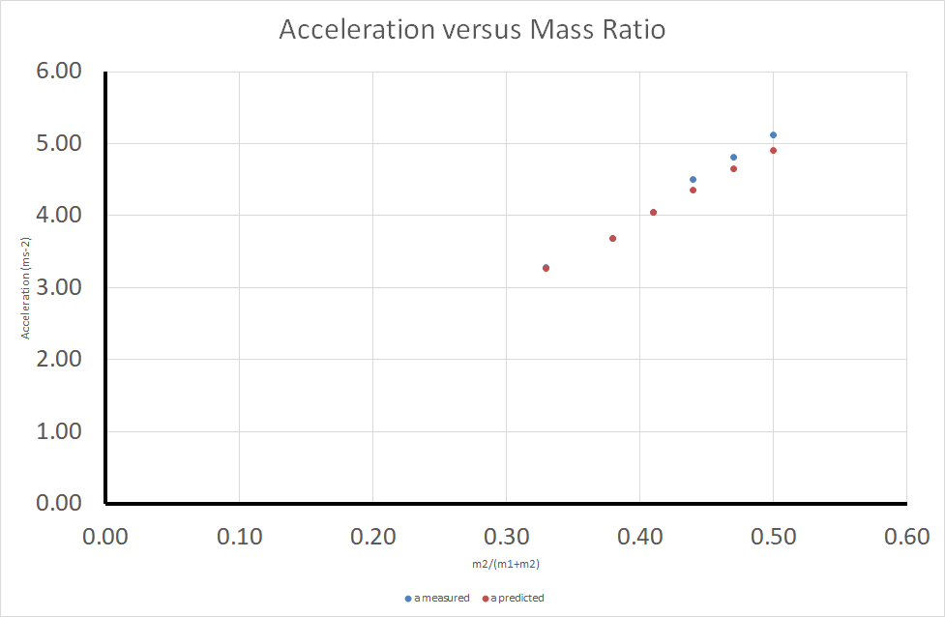
Copy and paste “m2/(m1+m2)” in to the x-axis title and “Acceleration (m∙s-2)” in to the y-axis title.
Part 1 – Producing a Good Graph

Slide 26
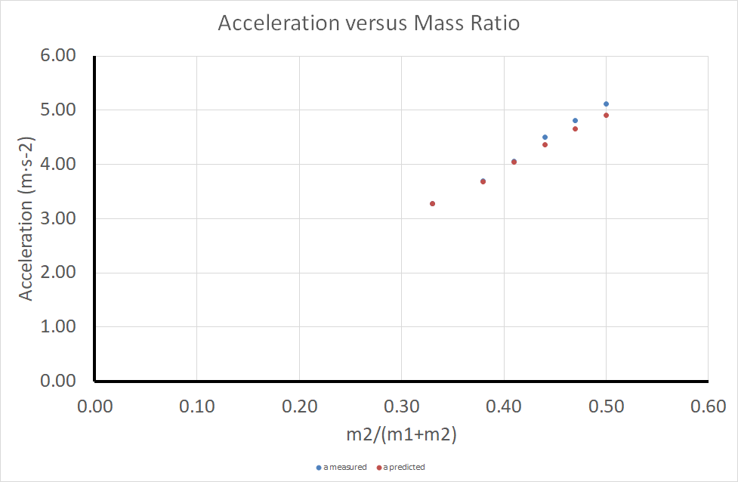
Left click on the x-axis title and increase the font size to 20. Do the same for the y-axis title. You may find you need to shrink the main graph at this point.
Part 1 – Producing a Good Graph

Slide 27
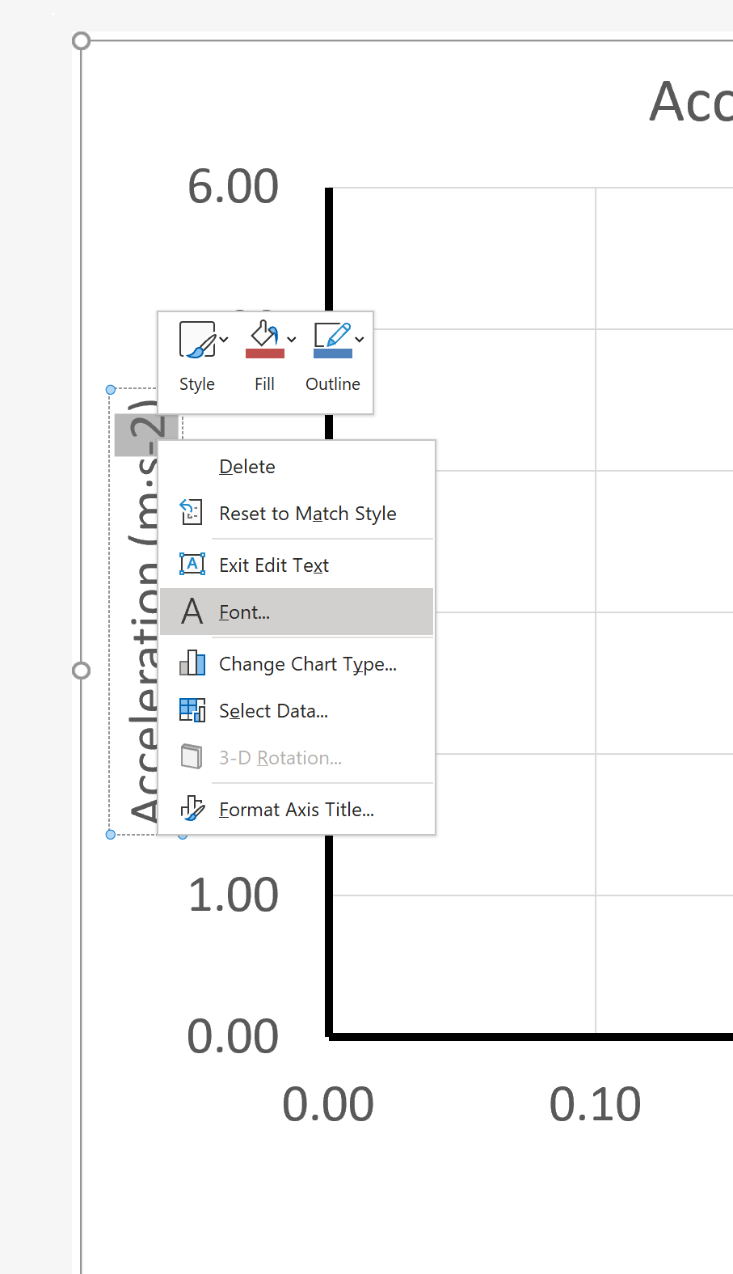
Highlight the “-2”, right click and select Font from the menu.
Part 1 – Producing a Good Graph

Slide 28
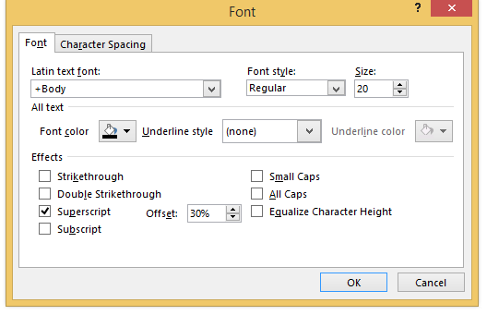
Select superscript from the option box and click OK.
Part 1 – Producing a Good Graph

Slide 29
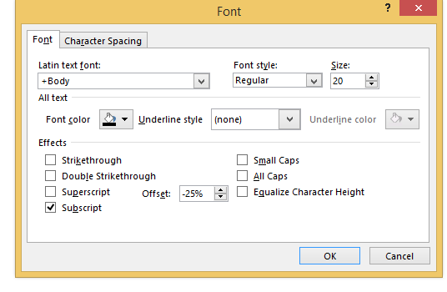
Now repeat this process for each of the numbers in the x-axis label. Except instead of superscript, click on subscript.
Part 1 – Producing a Good Graph

Slide 30

The graph should now look like this
Part 1 – Producing a Good Graph

Slide 31
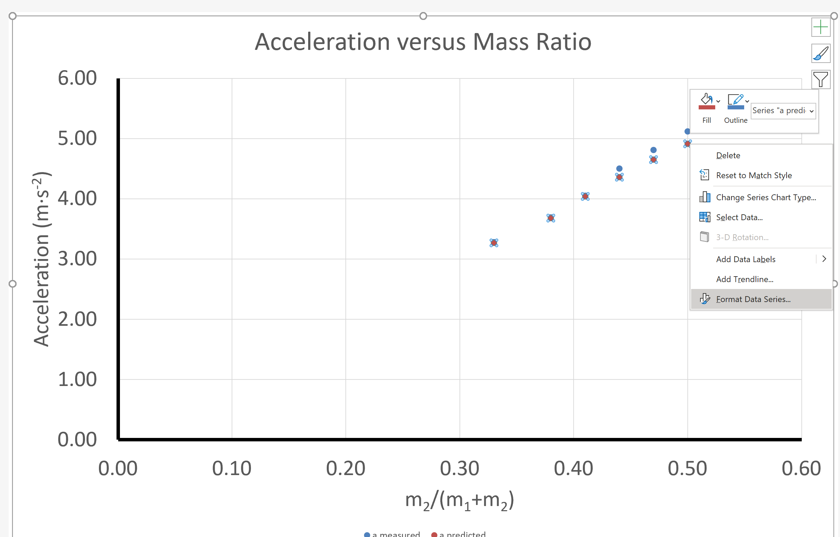
Click on one of the predicted values (red values), now right click and choose format data series from the menu.
Part 1 – Producing a Good Graph

Slide 32
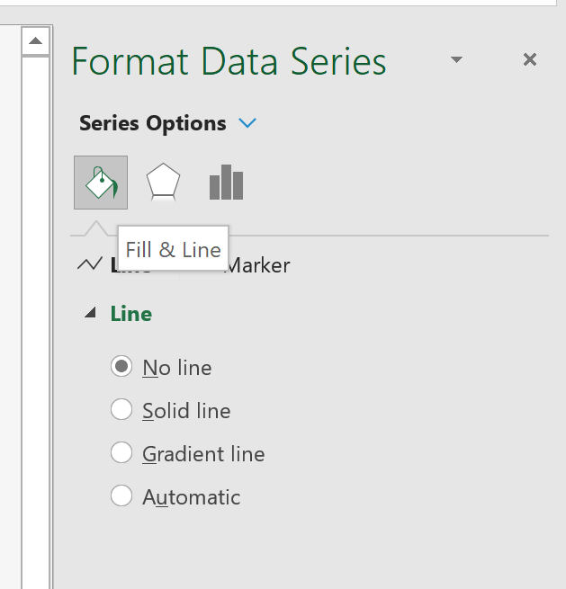
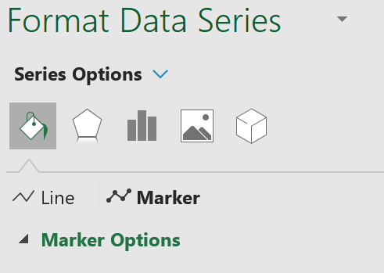
From the menu on the right side of the screen click on fill & line Then click on marker
Part 1 – Producing a Good Graph

Slide 33
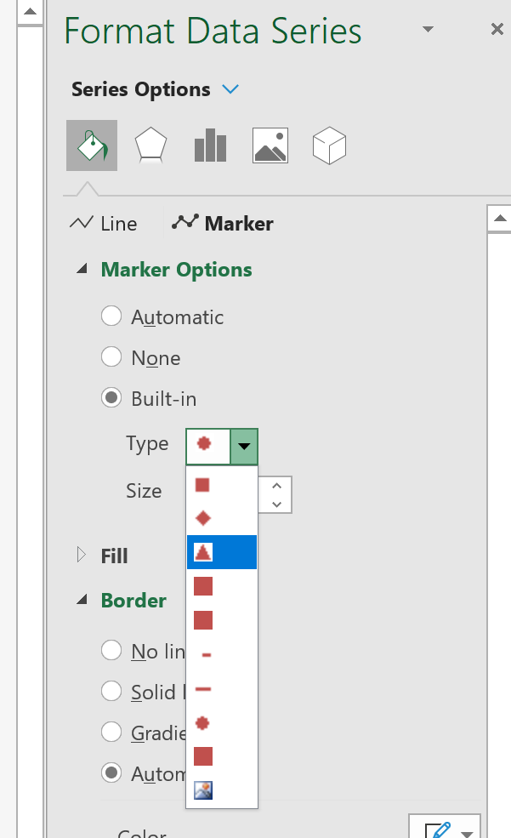
Next click on the marker options tab
Part 1 – Producing a Good Graph
Now choose the triangle symbol from the drop down menu

Slide 34
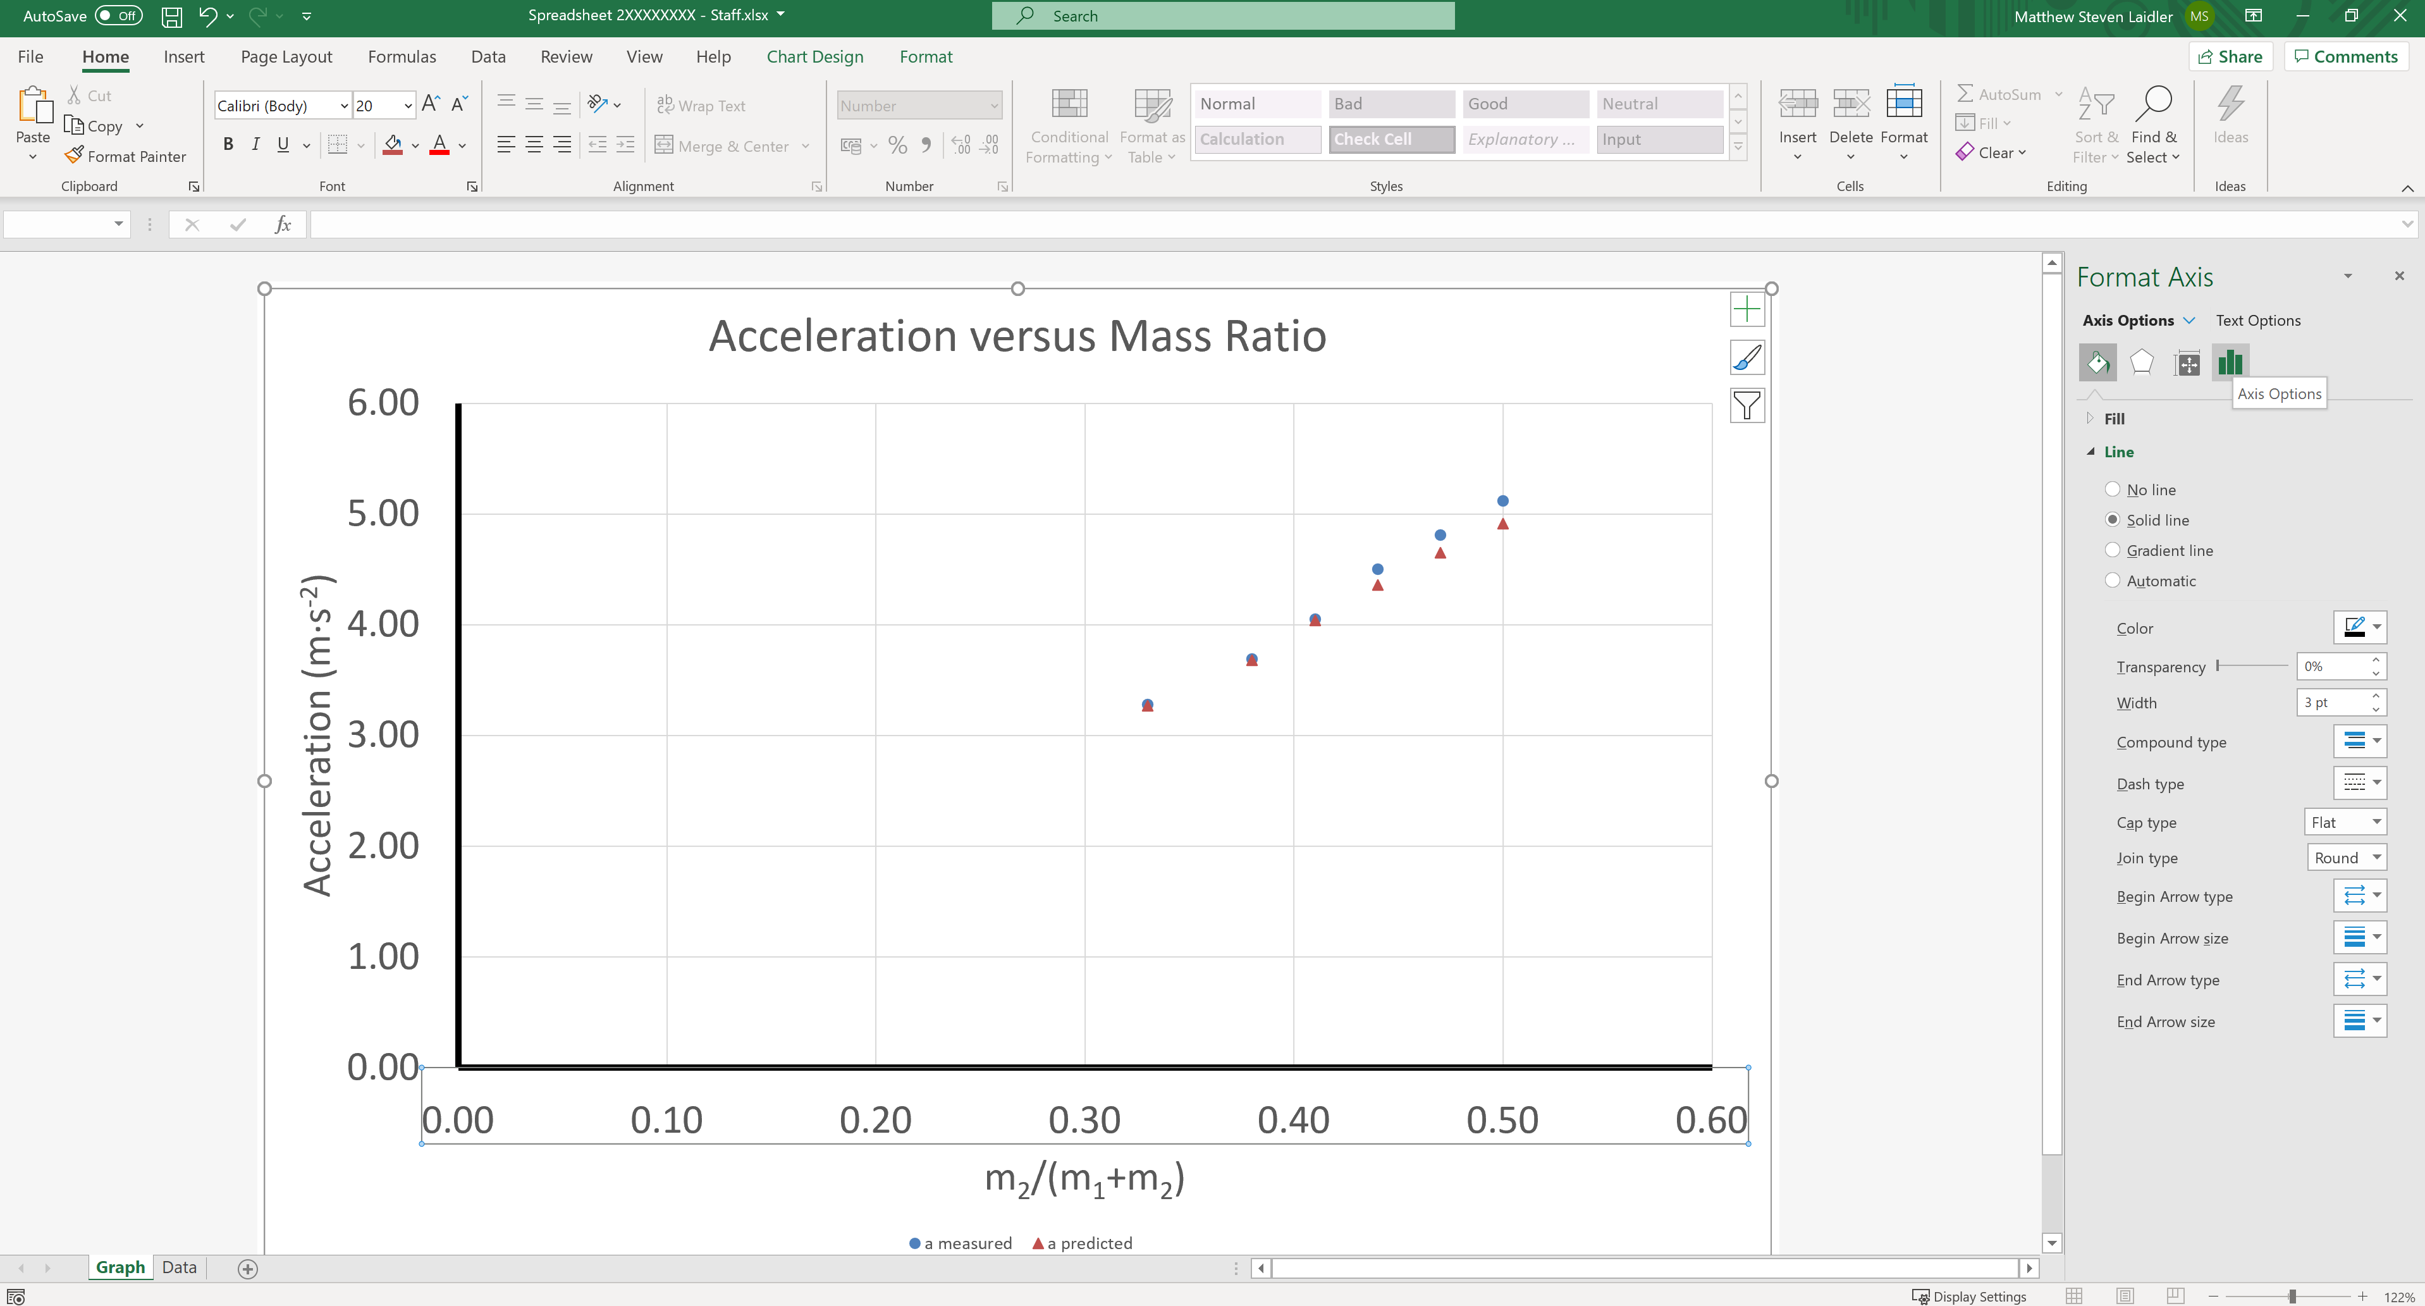
To finish off the graph, left click on the x-axis and choose Axis Options form the right hand menu.
Part 1 – Producing a Good Graph

Slide 35
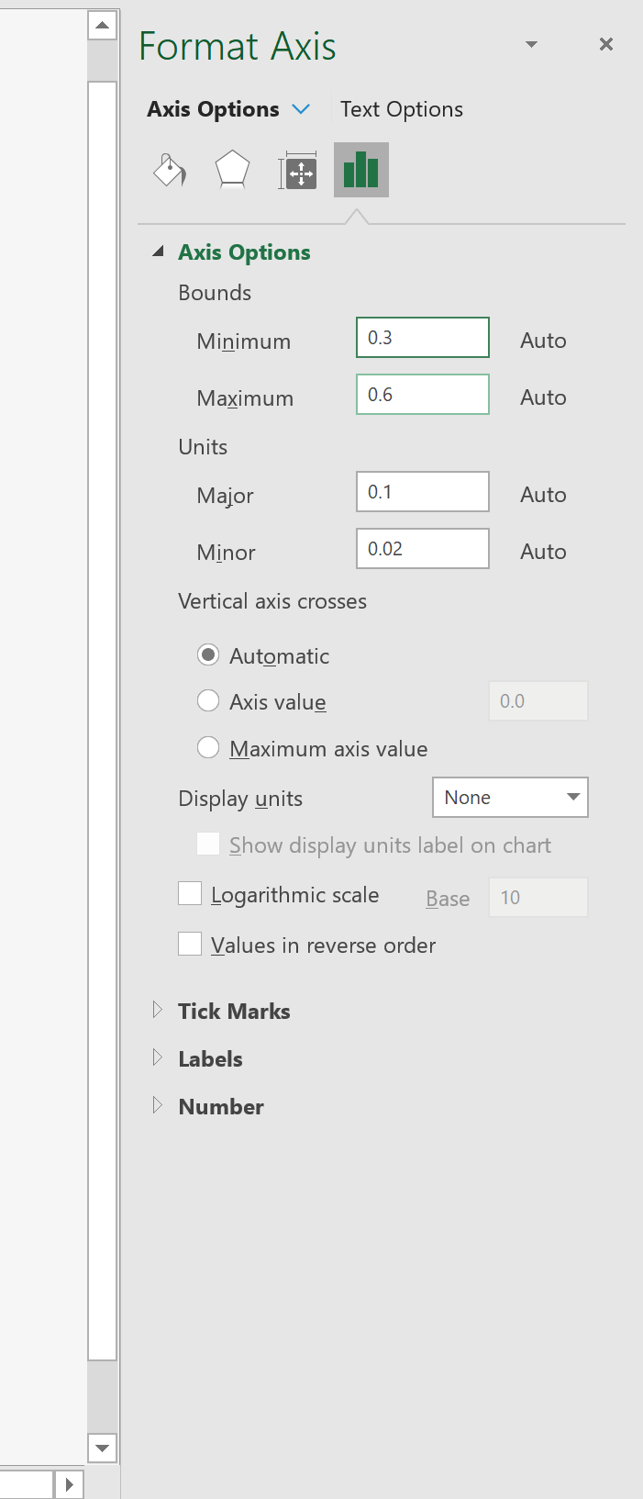
Set the Minimum Bound to 0.30
Part 1 – Producing a Good Graph

Slide 36
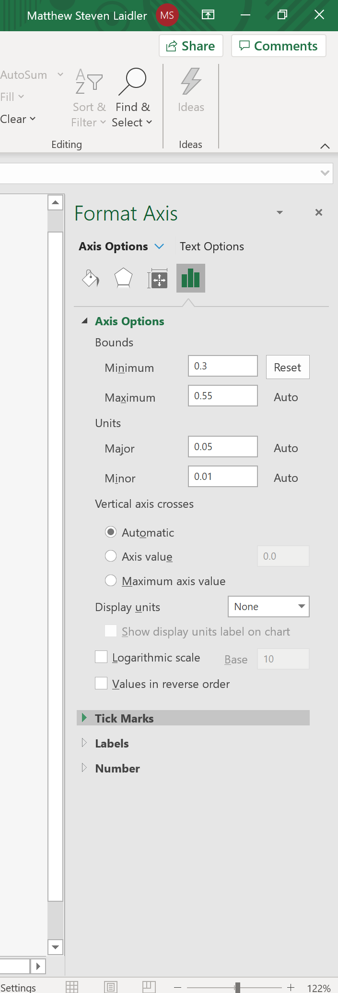
Now expand the Tick Marks menu
Part 1 – Producing a Good Graph

Slide 37
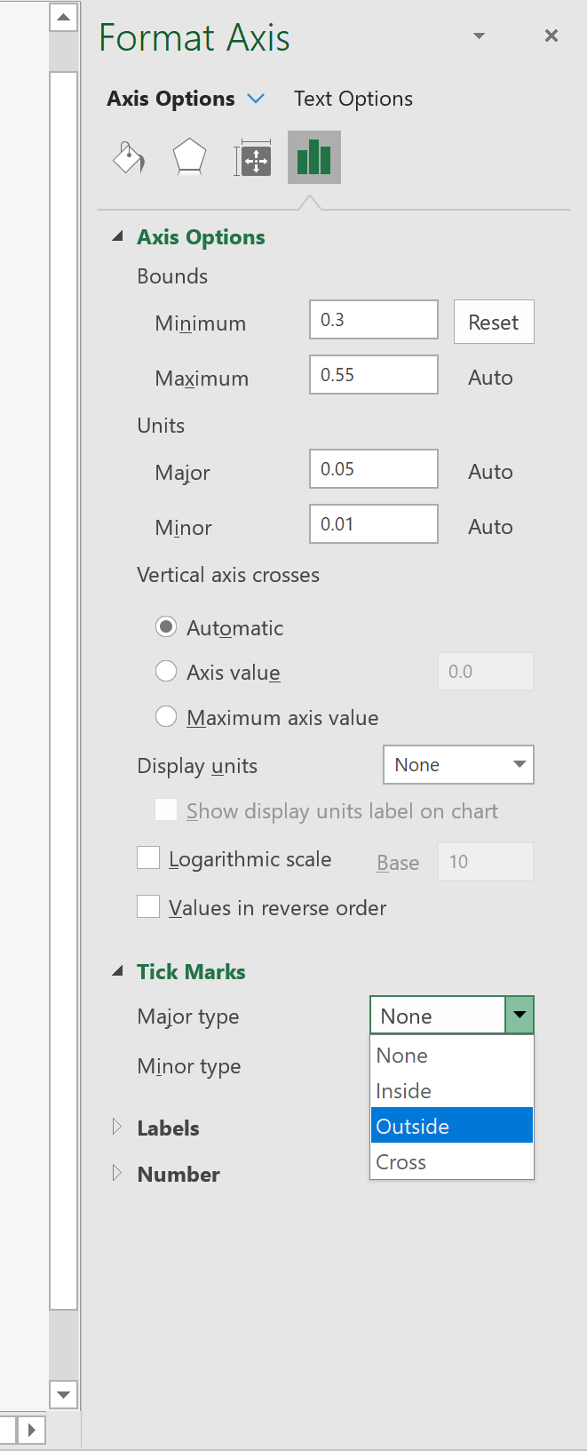
Set the Major Type to Outside
Part 1 – Producing a Good Graph

Slide 38
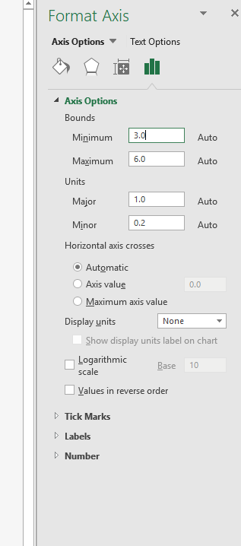
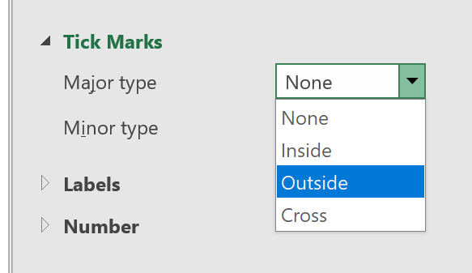
Repeat for the previous steps for the y-axis, set the Minimum Bound to 3.0 and add the Major Type Tick Marks to Outside
Part 1 – Producing a Good Graph

Slide 39
Part 1 – Producing a Good Graph
This completes the first task and your graph should look like the example below.

Slide 40

Good Graph Checklist
We have now covered the following areas
X
Title | Trendline
Data Spread | Equation and R²
Axis Labelled (including units) | Predicted and Measured Results
Appropriate Variables | Uncertainty Error Bars
X
X

Slide 41
Part 2
Representing Data with Excel:
Linear Trendlines

Slide 42

Part 2 – Linear Trendlines
Lets add the trendlines (line of best fit) to the sets of data

Slide 43
Make sure your graph looks like the one below before you start to add the trendlines
Part 2 – Linear Trendlines

Slide 44
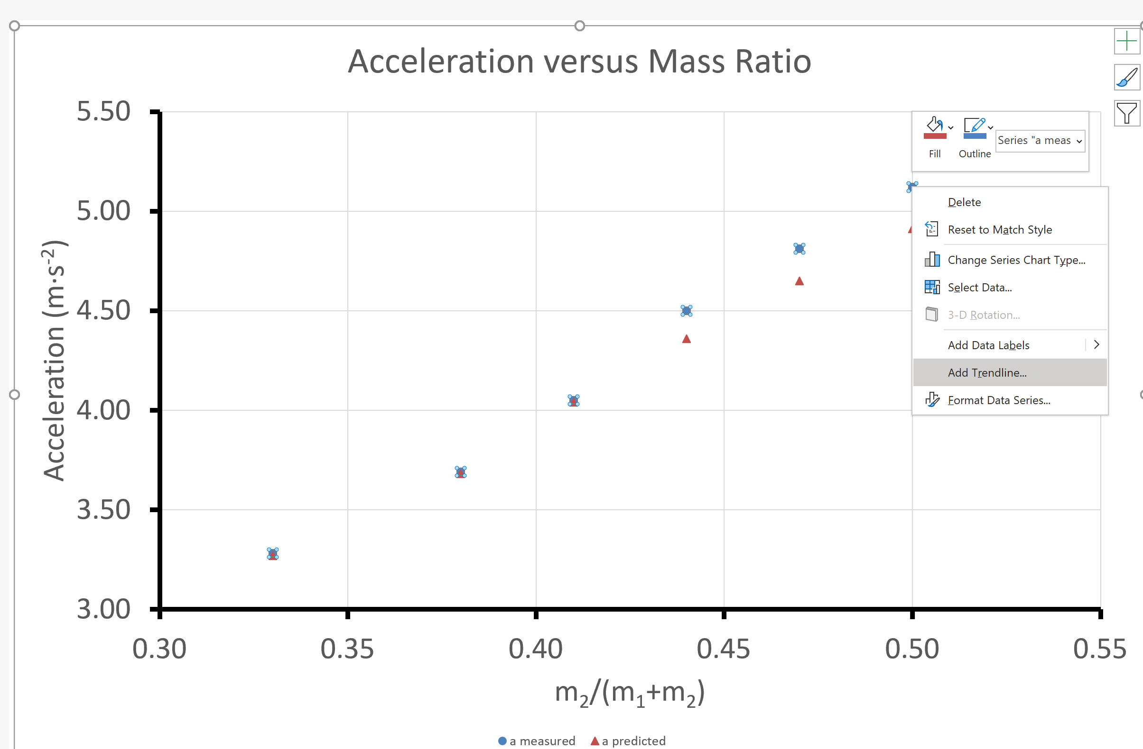
Right click over any data point from the measured data. From the menu select Add Trendline.
Part 2 – Linear Trendlines

Slide 45
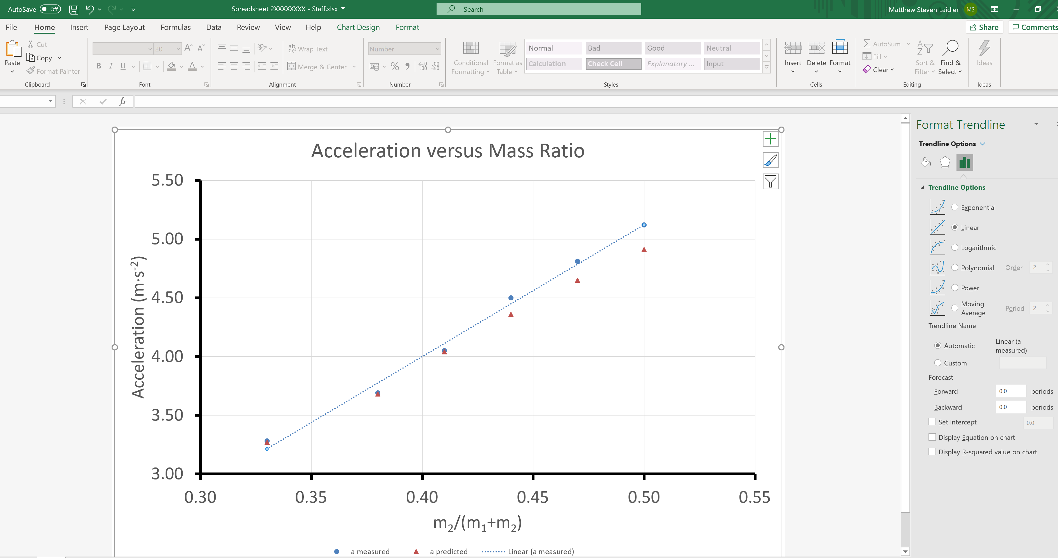
Select Linear from Trendline Options and select the “Display Equation on chart” & “Display R-squared value on chart”.
Part 2 – Linear Trendlines

Slide 46
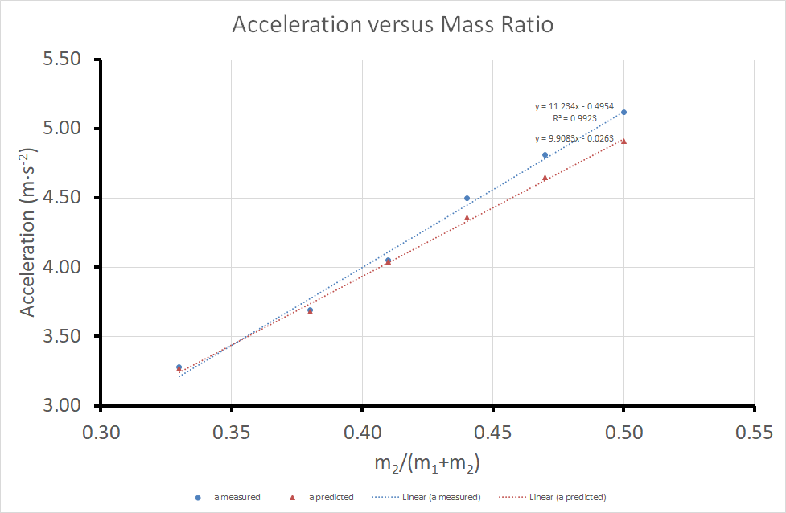
Now do the same for the predicted values (red data points). Note we don’t include R-sqaured for the predicted data set as it should be 1. Your graph should now look like this.
Part 2 – Linear Trendlines

Slide 47
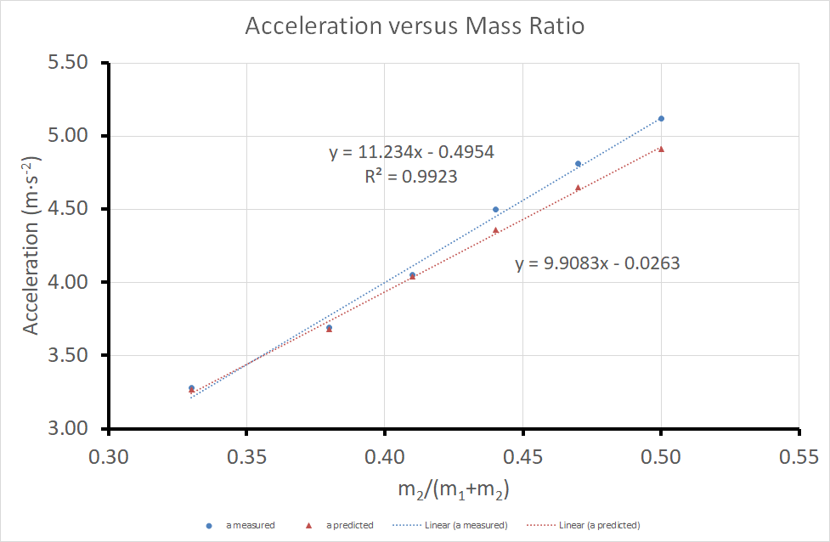
Next drag and drop the equations into the relevant region (see below) and increase the font size of the equations to 18.
Part 2 – Linear Trendlines

Slide 48
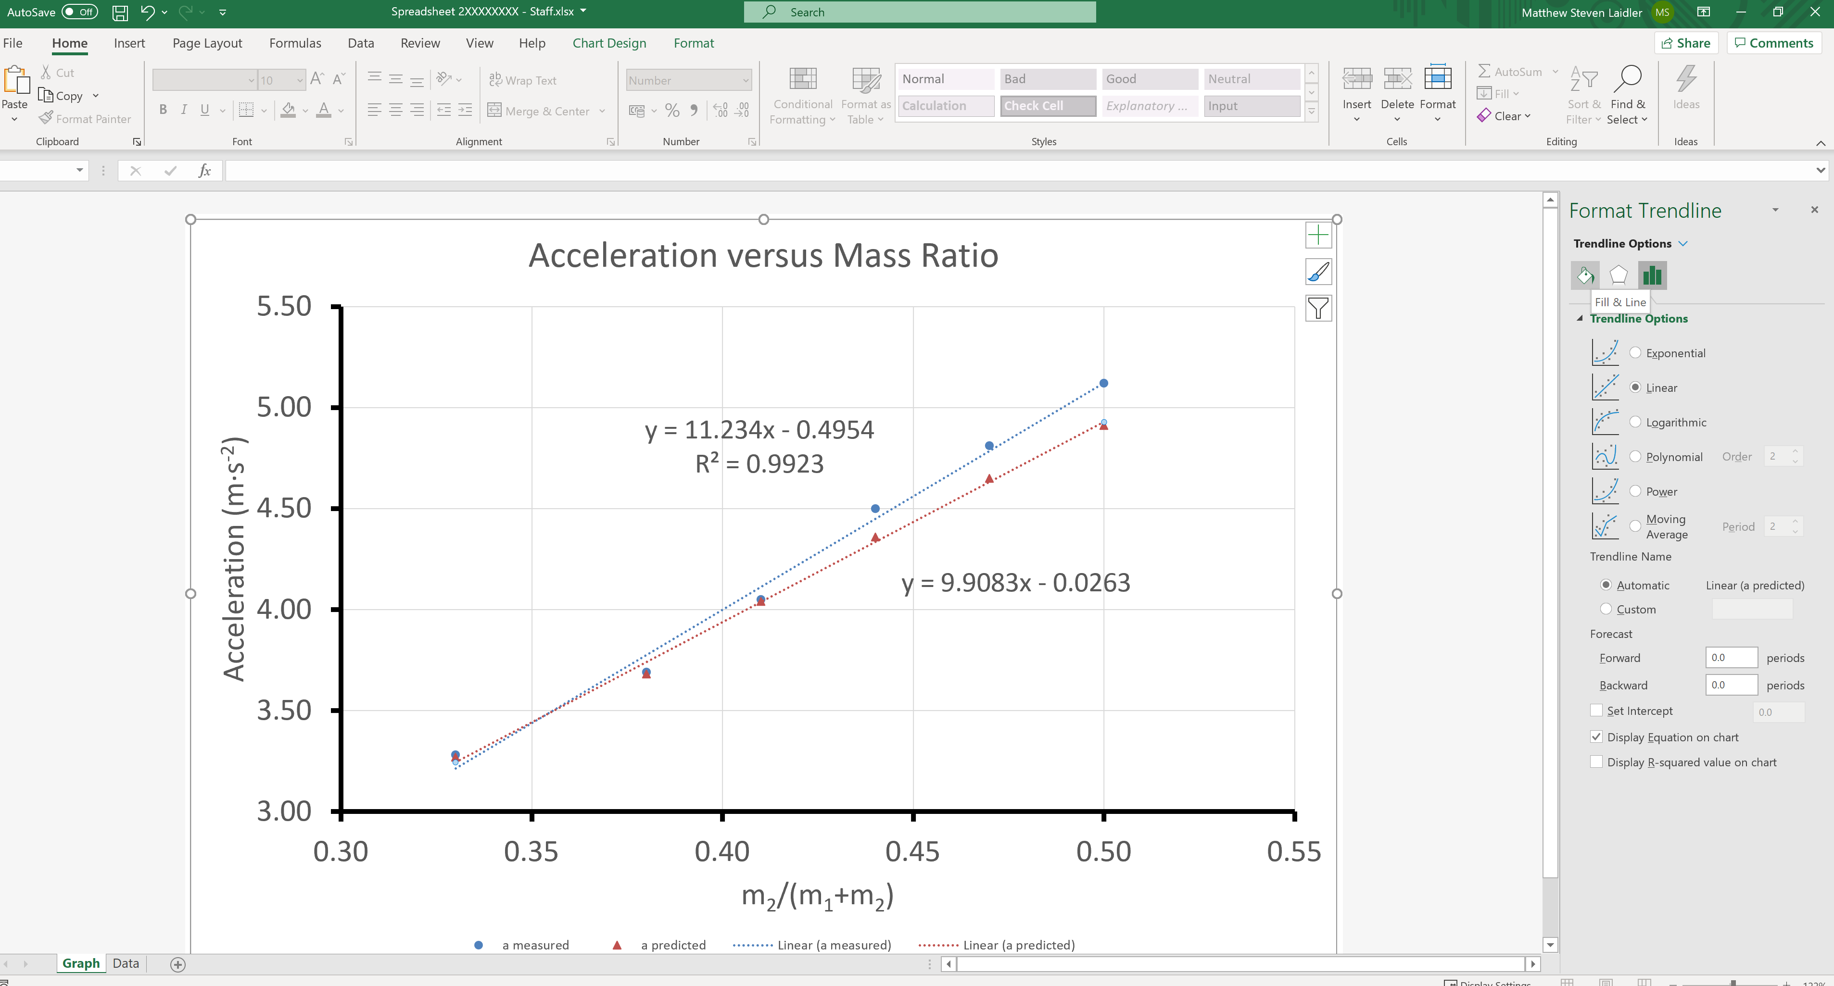
Finally left click on the predicted (red) trendline and select “Fill & line”
Part 2 – Linear Trendlines

Slide 49
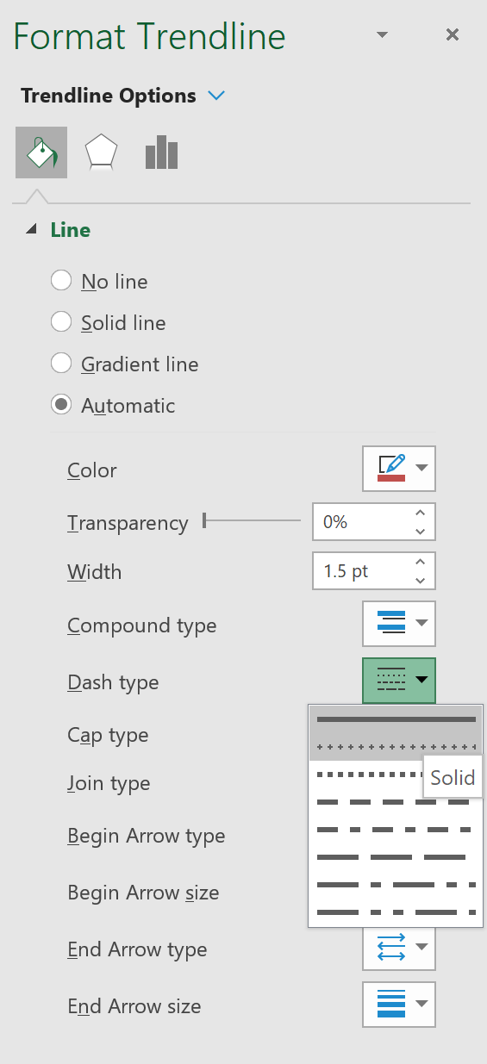
From the drop-down menu choose solid line type
Part 2 – Linear Trendlines

Slide 50
Part 2 – Linear Trendlines
This completes task two.

Slide 51
Good Graph Checklist
When producing an experimental graph it is useful to consider the following checklist
Title | Trendline
Data Spread | Equation and R²
Axis Labelled (including units) | Predicted and Measured Results
Appropriate Variables | Uncertainty Error Bars
X
We will cover how to produce a graph with all of these elements in todays computer lab.

Slide 52
Part 3
Representing Data with Excel:
Error Bars

Slide 53
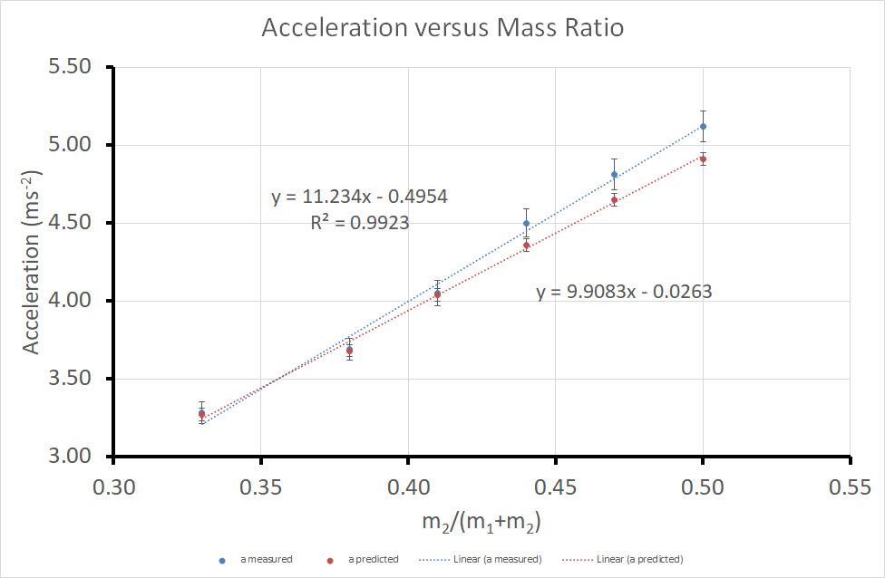
Let’s add the uncertainty error bars.
Part 3 – Error Bars

Slide 54
Make sure your graph looks like the one below for you start this task
Part 3 – Error Bars

Slide 55
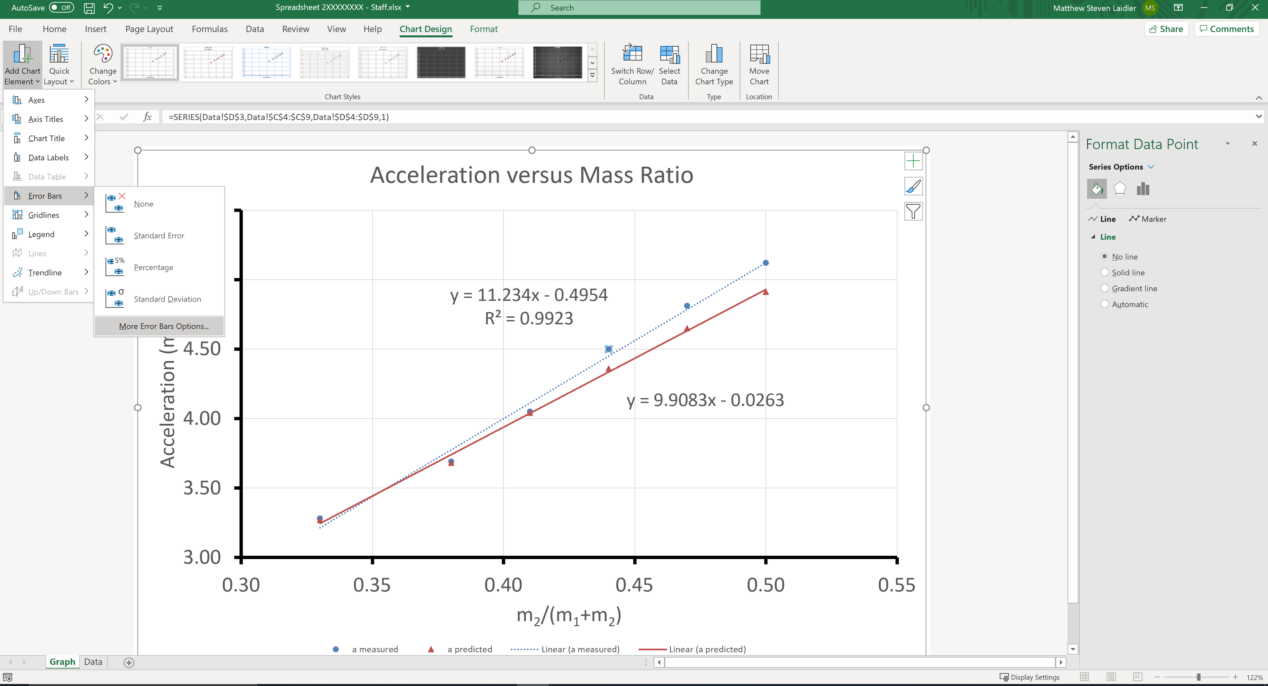
Left click on the a-measured data set. In the toolbar click Chart Design > Add Chart Element > Error Bars> More error Bars Options.
Part 3 – Error Bars

Slide 56
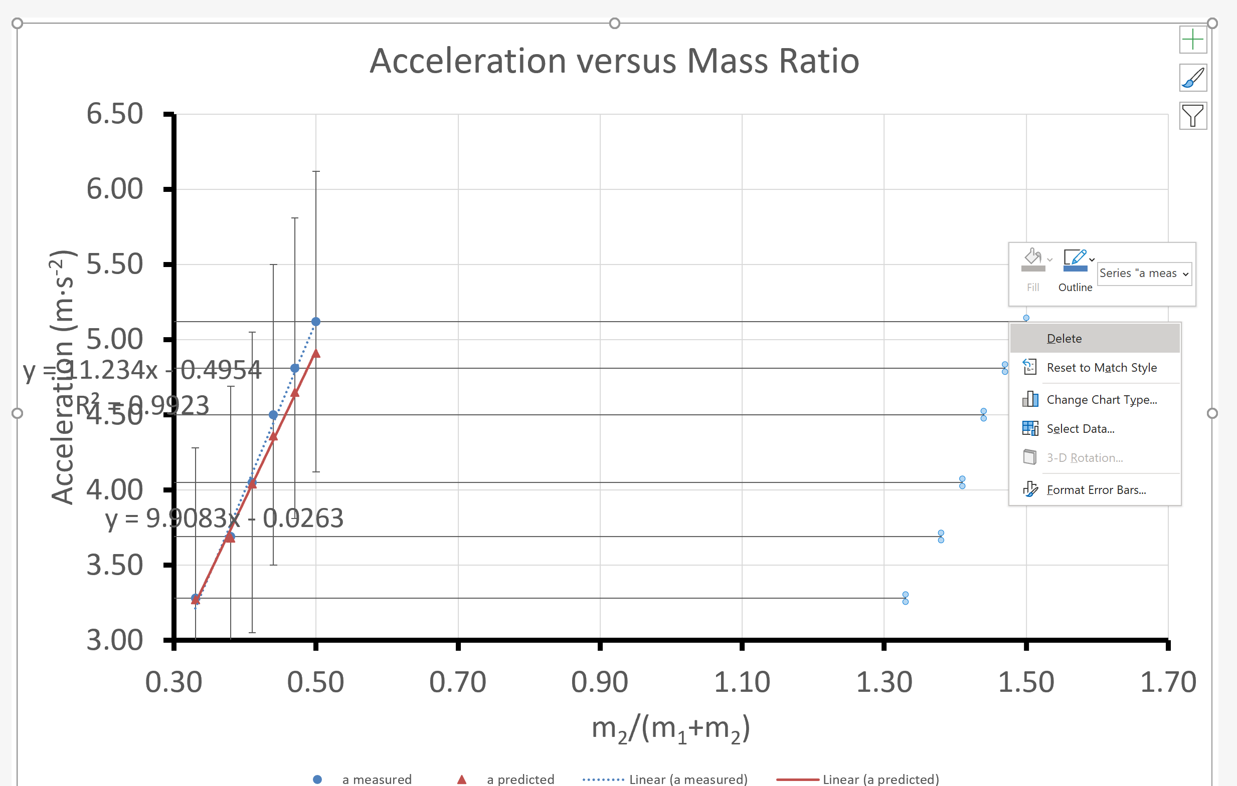
Left click and then right click the x-error bars, and choose the delete option from the menu
Part 3 – Error Bars

Slide 57

Left click on the y error bars, and select Error Bar Options from the righthand menu
Part 3 – Error Bars

Slide 58

Click Custom, and then click on the Specify Value to give a new window: Custom Error Bars
Part 3 – Error Bars

Slide 59

Part 3 – Error Bars
Click on the arrow of the Positive Error Value on the new window

Slide 60

Go to the Data sheet, and highlight the standard uncertainty δa_{m}
Part 3 – Error Bars

Slide 61

After you select the data the “Custom Error Bars” window should look like this
Part 3 – Error Bars
Now click on the arrow again

Slide 62
Click on the arrow of the Negative Error Bars on the new window and repeat the process, again choosing the values under δa_{m}
Part 3 – Error Bars

Slide 63

Go back to the Custom Error Bars window and click OK.
Part 3 – Error Bars

Slide 64

The graph should now look like this:
Part 3 – Error Bars

Slide 65

Now repeat the same process with the predicted data. When choosing the values to use for the error bars you should choose the following for the positive and negative values.
Part 3 – Error Bars

Slide 66
The graph is now complete and can be used for you report.
Part 3 – Error Bars

Slide 67
Good Graph Checklist
When producing an experimental graph it is useful to consider the following checklist
Title | Trendline
Data Spread | Equation and R²
Axis Labelled (including units) | Predicted and Measured Results
Appropriate Variables | Uncertainty Error Bars
We will cover how to produce a graph with all of these elements in todays computer lab.

